Slide 1
CSC101: INTRODUCTION TO COMPUTING
ELLIOT ATTIPOE
TEL: 024 387 9458
EMAIL: eattipoe@ucc.edu.gh

Slide 2
Course outline
Topics
  Digital Literacy
  Computer Hardware
  The Internet & Networks
  Digital Safety and Security
  Introduction to Python Programming
  Digital Marketing
Notes:
Mostly face-to-face
Occasionally – online

Slide 3
Assessment
Continuous Assessment (40%)
  Quizzes
  Homework
  Presentations
Exams (60%)

Slide 4
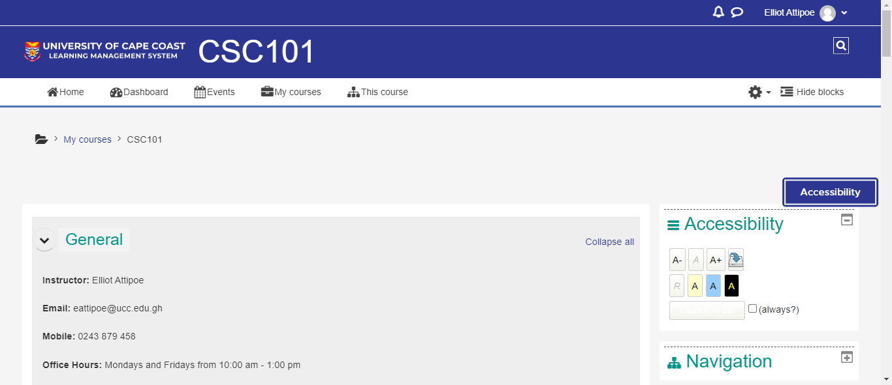
Learning management system (e-learning)

Slide 5
Why did you choose to study computer science?
Notes:
Own a computer
Get access to free Internet on Campus of

Slide 6
reasons to major in computing (acm)
Computing is part of everything we do!
Expertise in computing enables you to solve complex, challenging problems.
Computing enables you to make a positive difference in the world.
Computing offers many types of lucrative careers.
Notes:
Reasons to major in computing

Slide 7
Reasons to major in computing (acm)
Computing jobs are here to stay, regardless of where you are located.
Computing offers great opportunities for true creativity and innovativeness.
Computing is an essential part of well-rounded academic preparation.
Future opportunities in computing are without boundaries.
Notes:
Reasons to major in computing

Slide 8
What do you want to do with a computer science degree?

Slide 9
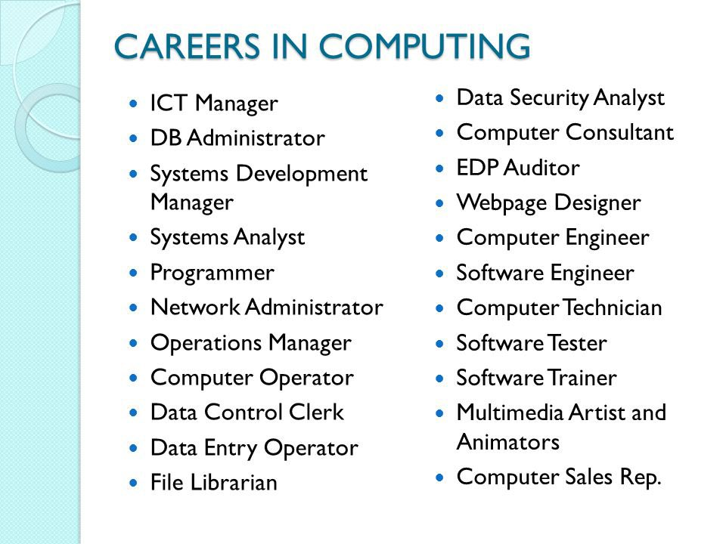
Notes:
EDP – ELECTRONIC DATA PROCESSING

Slide 10
What is the difference between computer science and information technology

Slide 11
CS VS IT
Computer science refers to designing and building computers and computer programs.
Information technology refers to maintaining and troubleshooting those computers and their networks, systems, and databases to ensure they run smoothly.

Slide 12
CS VS IT
Information technology) careers are more about installing, maintaining, and improving computer systems, operating networks, and databases.
Computer science (CS) focuses on using mathematics to program systems to run more efficiently, including in design and development.

Slide 13
CS VS IT
Computer science professionals use mathematics to develop and improve computer programs.
IT professionals install, implement, and maintain these programs and apply them to businesses.
Computer science professionals use skills in mathematics and theories to make information technology possible
IT professionals use skills to communicate with businesses to meet their needs through technology.

Slide 14
Computer science vs. IT careers
Jobs grounded in computer science will broadly mean working with programming languages or data to develop or improve products.
Jobs in IT will focus more heavily on the operation of computers, their networks, and systems, so that others in an organization can do their work smoothly.

Slide 15
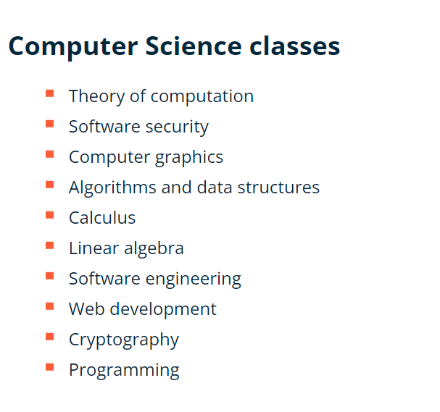
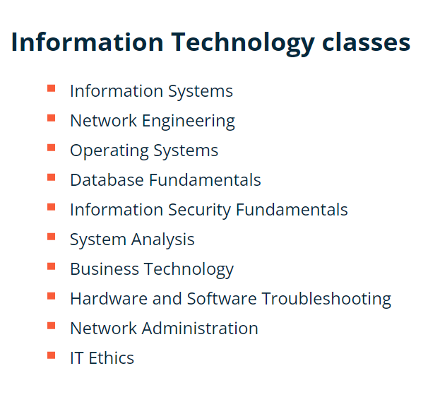

Slide 16
STRUCTURE OF CS PROGRAM (LEVEL 100)
CSC 101: Introduction to Computing
CSC 102 Programming Techniques
CSC 107: Software Suite
PHY 101: General Physics I (Theory)
PHY 103: General Physics I (Practical)
MAT101: Algebra and Trigonometry
MAT 102: Analytic Geometry and Calculus
PHY 102: General Physics II (Theory)
PHY 104: General Physics II (Practical)
STA 102: Introduction to Statistics

Slide 17
STRUCTURE OF CS PROGRAM (LEVEL 200)
CSC 203: Programming and Problem Analysis I
CSC 211: Computer Architecture
CSC 213: Database Management I
MAT 201 Introduction to Abstract Algebra
MAT 203: Further Calculus
CSC 212: Algorithms
CSC 214: Operating Systems
CSC 216: Database Management II
MAT 202: Vector Algebra and Differential Equations
STA 202: Further Statistics

Slide 18
STRUCTURE OF CS PROGRAM (LEVEL 300)
CSC 311: Computer Security
CSC 315: Discrete Mathematics
CSC 317: Software Engineering
CSC 319: Data Structures:
MAT 301: Advanced Calculus I
CSC 302: Programming and Problem Analysis II (Java)
CSC 312: Human Computer Interface
CSC 314: Network Computing I
CSC 316: Web Technologies
CSC 399: Research Methods

Slide 19
STRUCTURE OF CS PROGRAM (LEVEL 300)
CSC 401: Introduction to Compilers
CSC 405: Advanced Operating Systems
CSC 411: Introduction to Artificial Intelligence
CSC 413: Computer Graphics
CSC 415: Network Computing II
CSC 402: Numerical Analysis
CSC 406: Systems Administration
CSC412: Cryptography and Network Security
CSC 408: Operations Research
CSC 499: Project Work

Slide 20
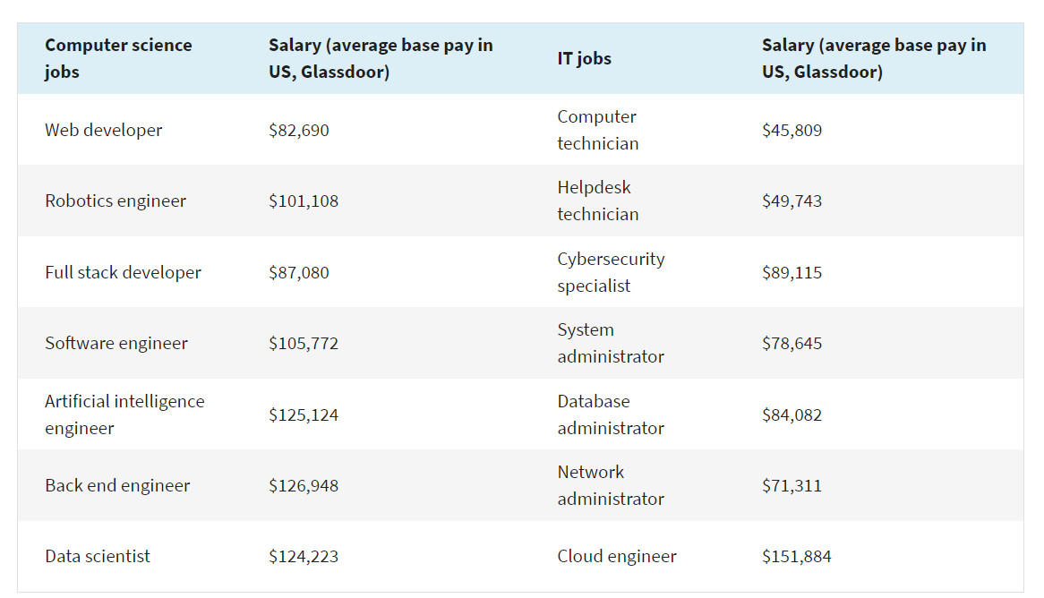

Slide 21
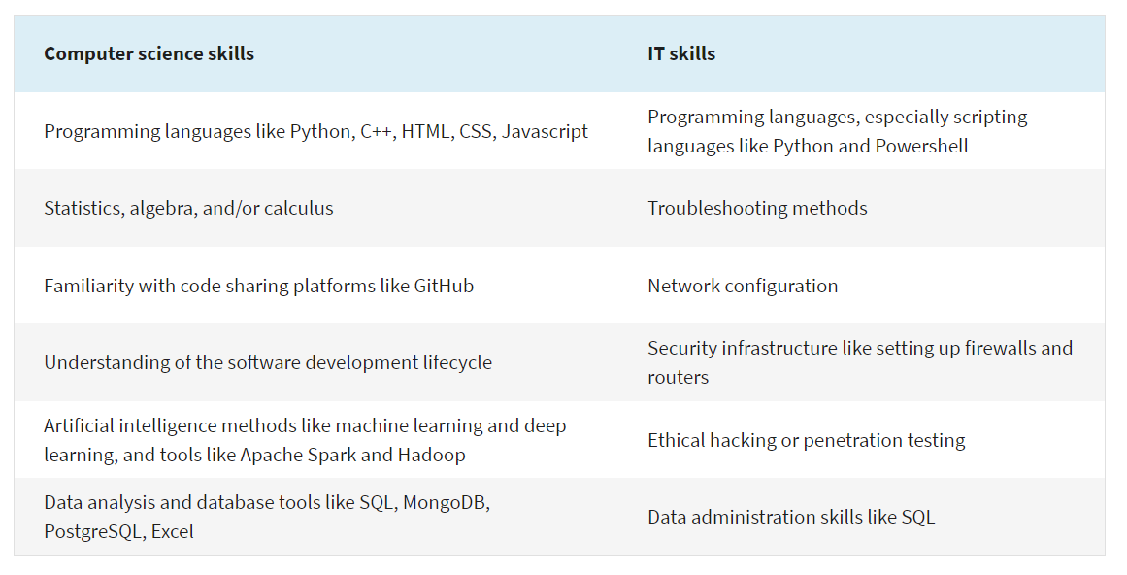
Notes:
IT skills and computer science skills

Slide 22
Computer science specialization
Artificial Intelligence
  Skills: Mathematics and analysis, algorithms, predictive modeling
  Common Roles: Artificial Intelligence Architect, Artificial Intelligence Researcher, Machine Learning Engineer
Computer-Human Interface
  Skills: Communication, interpersonal skills, attention to visual detail, mapping how people use software and systems
  Common Roles: User Experience (UX) Designer, User Experience Researcher, Interaction Designer

Slide 23
Computer science specialization
Computer Graphics
  Skills: Attention to visual and artistic detail, collaboration, creativity
  Common Roles: Mobile Application Developer, iOS Developer, Android Developer
Information Security
  Skills: Communication, threat/vulnerability management, knowledge of security compliance rules and regulations
  Common Roles: Security Engineer, Network Security Analyst, System Security Analyst

Slide 24
Computer science specialization
Programming Languages
  Skills: Coding and scripting in multiple languages, collaboration
  Common Roles: Full-Stack Web Developer, Front-End Developer, Game Developer, Software Programmer
Software Engineering
  kills: Coding and scripting, communication, collaboration
  Common Roles: Software Development Engineer, Software Engineer

Slide 25
Computer science specialization
Game Design
  kills: Attention to visual detail, collaboration, coding, and scripting
  Common Roles: Video Game Designer, Video Game Developer, Software Engineer
Data Science
  Skills: Mathematics and analytics, attention to detail, predictive modeling
  Common Roles: Data Scientist, Data Analyst, Business Intelligence Analyst, Machine Learning Engineer, Information Scientist, Database Administrator

Slide 26
Computer science specialization
Networks
  Skills: Diagnose and troubleshoot network issues, design network architecture
  Common Roles: Network Administrator, Network Analyst, Network Architect
Theory
  Skills: Mathematics and analytics, predictive modeling and probability, big-picture planning
  Common roles: Algorithm Scientist, Machine Learning Engineer

Slide 27
Assignment
What is Artificial intelligence?
List 10 applications of Artificial intelligence?
Discuss roles, benefits and drawbacks of artificial intelligence?
Deadline: January 31, 2023
Do not exceed 2 pages

